Slide 1
Department of Finance
2024 Year In Review
Presented by Jon Horton, CPA
Director

Slide 2
Department of Finance
Jon Horton, CPA
  Director
Debby Scott
  Senior Accounting Associate
BRigete Davenport
  Accounting Associate II
Felicia Diggs
  Accounting Associate II
  This team has been together since 11/13/2023
Notes:
This entire staff was not present on April 15, 2023. Debby was kind enough to come out of retirement to help us out. The value of her experience and skills cannot be overstated. BRigete came to us from the City of Grand Prairie and assisted with recruiting Felicia from there as well.

Slide 3
Department of Finance
The City’s Finance Department has three main objectives:
Provide timely and materially correct financial reports
Safeguard the financial assets of the City
Ensure those who do business with the City are paid in a timely manner.

Slide 4
Major Projects in 2024
Fiscal year(FY) 23 Annual Comprehensive Financial Report
  Unmodified Opinion issued by FORVIS (Now known as Forvis Mazars)
Water Rate Study
  Final presentation to Council in July 2024 included a five year rate plan to ensure financial stability of the water/wastewater fund.
  This plan includes coverage for projected operating costs and debt payments.
$3.0MM General Obligation Bonds
  Voter approved in November 2023
  Bonds sold in September 2024
$11.0MM Certificates of Obligation Bonds
  $8.4MM for Public Safety facility renovations
  $2.6MM for infrastructure projects
  Bonds sold in September 2024

Slide 5
Major Projects in 2024
FY25 Budget
  Adopted in August 2024 (one month ahead of the previous FY)
External Storage Elimination
  Account closed and boxes delivered. Contents are being staged for scanning and/or destruction
Shift from STW to Tyler ERP Pro
  Major software shift from a legacy on-premises software to a cloud-based software
  Revolutionization of Accounts Payable (coming in 2025)
    Online Approvals
    Paperless within the Department
  Massive advancement with fixed asset and project tracking
    No longer using supporting spreadsheets on our server. Have moved this within the software

Slide 6
Major Projects in 2024
Policy Review
  The following policies were reviewed and added to the Employee Handbook*:
    Fraud
    Purchasing
    Procurement Card Program
    Cash Handling
  The Investment Policy was reviewed per the PFIA
  *Employee Handbook is still under review

Slide 7
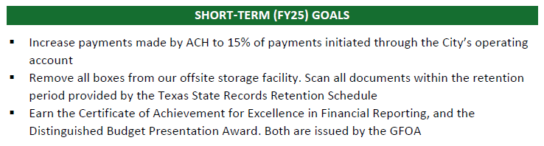
Goals Check-In
As presented in the FY25 Budget:

Slide 8
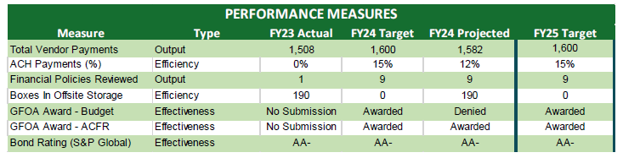
Goals Check-In
As presented in the FY25 Budget:

Slide 9
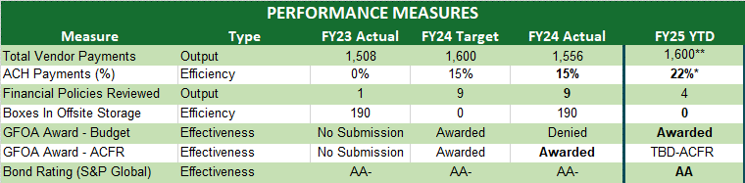
Goals Check-In
Updated FY24 Figures with FY25 Projections:
**Projected
*Reflects actual 1Q FY25 activity
Notes:
458 total payments, 101 of which were made electronically

Slide 10
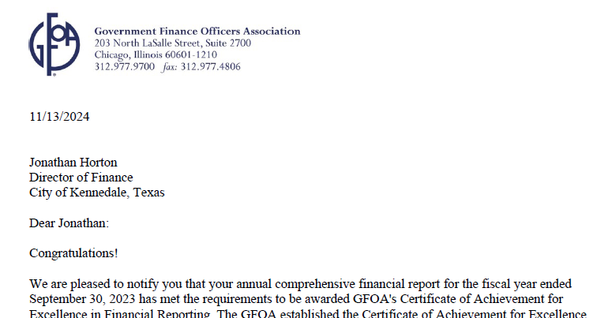
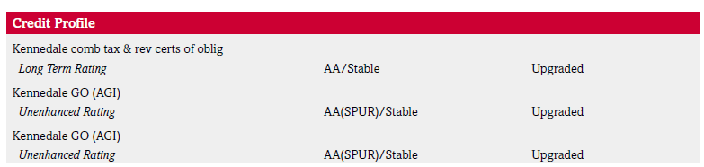
Recognized Efforts
Certificate of Achievement for Excellence in Financial Reporting from the Government Financial Officers Association
S&P Global Ratings raised its ratings to ‘AA’ from ‘AA-’

Slide 11
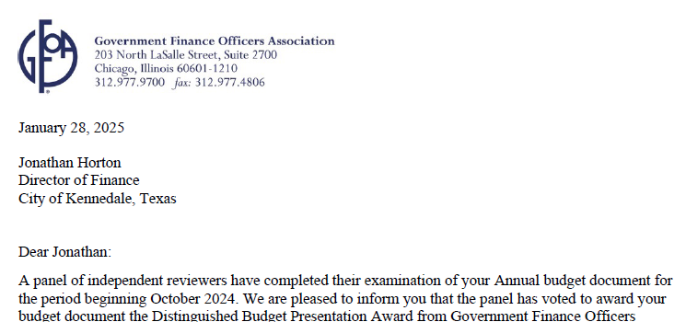
Recognized Efforts
Distinguished Budget Presentation Award from the Government Financial Officers Association

Slide 12
General Fund Revenue Analysis
FY24 Figures are unaudited.
Notes:
Other includes Fines and Fees, Charges for Services, Grants and Contributions (FY22 and 23), Intergovernmental, Licenses and Permits, Transfers from other Funds, Investment Revenue, ETC

Slide 13
General Fund Revenue Analysis
Other includes Licenses and Permits, Fines and Fees, Chargers for Services, Intergovernmental, Transfers, Investment Income, and Miscellaneous Revenue Sources

Slide 14
General Fund Revenue Analysis
Additional resources from General Fund revenue sources between FY22 and FY25 budgets
  8 new personnel
    Court – 2
    Community Development – 1
    Library – 1
    Fire Department – 2
    Public Works – 2
  New software for Court, Community Development, and Finance.
  Pavement Management System for Public Works
  Vehicles Purchased (new): 4 Patrol Vehicles, 1 Animal Control Vehicle, 1 Truck for Community Development

